Slide 1

Social management, including equity and safeguards
Relevance & Application in
Support to
TEQIP- III
Surbhi Dhingra
World Bank

Slide 2
First, A Game…

Slide 3
You have one job…
Say out loud the color of the shape you see on the screen.
Notes:
Lets do this quick activity as a very basic example (STROOP)

Slide 9
BLUE
Notes:
So some of you did the requested task and said “red”, the color of the shapes on the screen. Others of you read the word “blue” – what happened there? This activity is called a Stroop Test. It measures impulse control. The task seems simple, and you knew exactly what to do. Yet, without concentrating hard, the task is actually difficult. You may be familiar with Daniel Kahneman’s book “Thinking fast and slow,” a prominent work in the behavioral science field – here I was making you think fast and your instinct to read took over your concentration on the task I requested. This in a short way introduces the idea that cognitive operations are quite complicated and sometimes can result in outcomes at odds with our intentions.

Slide 10
The game tries to test our impulse control- displaying behavior characterized by little or no forethought, reflection, or consideration of the consequences.
Sometimes un-intentionally we show bad behavior towards students, esp. underprivileged – SC/ST and Women

Slide 11
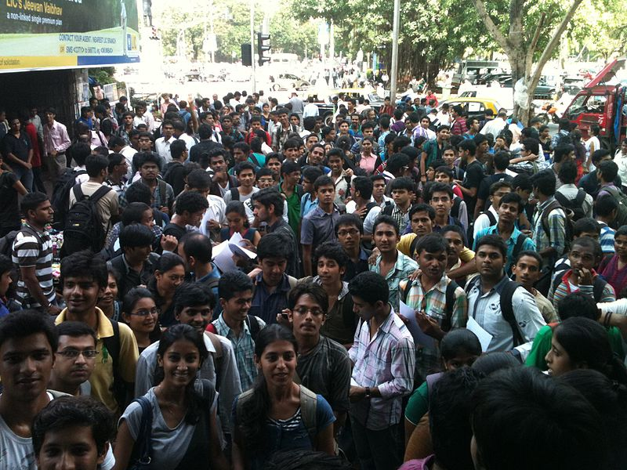
The Experience of SC, ST and Women Students in Engineering – TEQIP-I & II

Slide 12
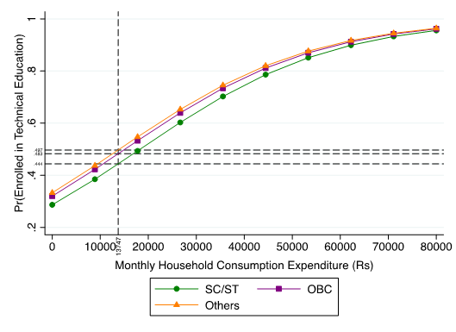
Access to technical education more equitable now
Probability of Enrolling in Technical Education versus General Education (SC- ST/OBC/Others)
2008
2014
Source: NSS 64th and 71st Round

Slide 13
“I just want to leave – I don’t belong here”
Ragging
Discrimination in hostels
Discrimination in the classroom and in laboratories
Visible markers of caste among faculty and students
“Many faculty members wear strong caste symbols, such as ash on their forehead. Students with similar caste markers are viewed favourably”

Slide 14
“Suddenly, everything is in English”
Lack of fluency in English is an immediate barrier for SC/ST students; even those who can speak English, have a different accent and are thus ‘identified’
  Alienates them from many aspects of intellectual, social and cultural life
“SC/ST students study in Hindi all their life, write the entrance in Hindi, but then have to suddenly adapt to an English-only course. Our college system really failed them here”
“We had to consult the dictionary 10 times for every page we studied.”

Slide 15
Education: Is it really free?
No.
Delays in tuition and fellowship disbursement puts great stress on students and their families, who take loan upon loan
Other charges (hostel charges, exposure trips, and laboratory costs). There are financial costs to trying to fit in.

Slide 16
“Students entering through SC/ST quota are made acutely aware of it…and of being “unteachable”
Strong discourse of merit and argument that quality has come down because of SC/ST students
SC/ST students are seen as “rotten apples” incapable of behaving in a sexually respectable manner and likely to “corrupt” other students

Slide 17

Safeguards
Rule # 2
Go Good

Slide 18
Safeguard Policies- relevant to the project
10 safeguard policies
OP 4.10: Indigenous / Tribal (ST) – Equity Action Plan
  Emphasis / encouragement to the vulnerable students (ST)
    Inadequate exposure to ‘real world’
OP 4.12: Land acquisition – Labor Management Plan
  No land to be purchased
  Civil works on existing land
  Labor management during civil works
    Safety of labor, students and faculty

Slide 19
OP 4.10 – Indigenous People
Ensuring Equity
  What is equality?
  Equal distribution!

Slide 20
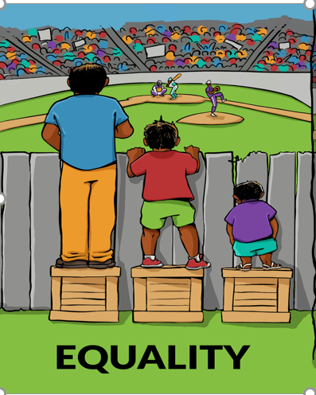

Slide 21
What is equity?
  Being fair and impartial!

Slide 22


Slide 23
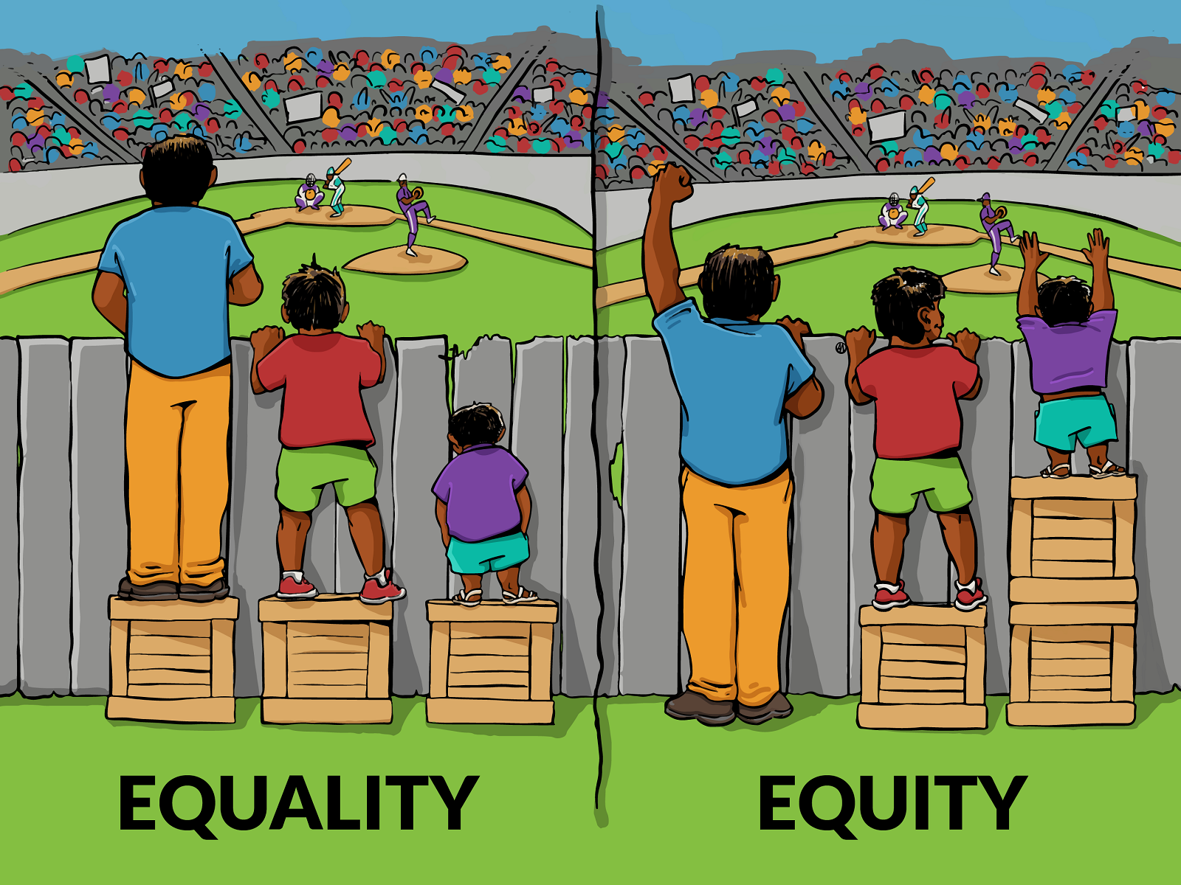
Which approach should we adopt?
Picture A Picture B

Slide 24
Equity Action Plan: Objective
  To ensure that all students and faculty in the participating Technical Institutions have:
  equal opportunity to avail the benefits of the project
  substantial improvement in the performance of students
  special attention to the students that need greater assistance, with particular focus to SC and ST students
  *SPIUs to help institutes in thinking of various ways they can improve student performance and satisfaction, resulting in better employability, and placement.

Slide 25
EAP: Proposed Activities
I. STUDENT-CENTERED STRATEGIES TO IMPROVE ACADEMC PERFORMANCE
Activity | Action
1. Institutions to identify and support students who need extra support – for e.g. students who lost a year or more during their degree programme | Diagnostic test
 | Based on diagnostic test- identification of areas or specific topics in which a particular student needs more support
 | Appointment of Mentors: Faculty Mentors / Advisors FA to give academic as well as personal advice
 | Promoting Peer Learning Groups - groups of 10-12 students to assist each other
 | Bridge courses (e.g. extra classes, tutorials by faculty or senior post-graduate students)

Slide 26
STUDENT-CENTERED STRATEGIES TO IMPROVE ACADEMC PERFORMANCE
Activity | Action
2. Improving language competency, soft skills and confidence levels | English language labs where students can listen to tapes and use workbooks to improve their English, particularly spoken English
3. Improving non-cognitive and soft skills | Special labs or workshops / sessions with external experts/ consultants / faculty / senior students
 | Ensuring students have the opportunities right from the first year to develop and make presentations in the classroom
4. Improving placement of students | Greater networking with industry by organizing Industry fest
 | Establishing Industry‐Institute Partnership Promotion Cells / Placement cells Placement officer
 | Conducting annual meet of alumni

Slide 27
II. IMPROVING TEACHER EFFECTIVENESS- Faculty Development Program:
Activity | Action
1. Updating Domain Knowledge | Promoting faculty for PhD
 | Enrolling few faculties every year at nearby QIP center for qualification upgradation
 | Promoting faculty to participate in research, development activities and consultancy
 | Deputation to seminars, conferences and presentation of research papers- expenses to be borne by the institute as per the applicable norms
 | Enhanced interaction with industry
 | Conducting Professional Development Programme for faculty

Slide 28
IMPROVING TEACHER EFFECTIVENESS
Activity | Action
2. Training in pedagogy, particularly to improve the performance of students that need additional support | Training Needs Analysis (TNA) to be carried out by external expert for all teachers to understand the skills required to teach weak students
 | Prepare Faculty Development Plan using identified providers for Pedagogy (IITs) or National Training Calendar for subject training, giving priority to the teachers with the most significant gaps in knowledge and skills as diagnosed by the TNA
 | Domain training on the need basis - Link up with industry to keep abreast of cutting edge technology
 | Institutions to submit half-yearly reports to the SPIUs regarding training (progress)
 | Carry out Satisfaction Surveys to assess training achievements

Slide 29
IMPROVING TEACHER EFFECTIVENESS
Activity | Action
3. Teacher’s counselling | Approaches to dealing with students that need additional support; SC/ST and women students
4. Faculty appraisal | Self-assessment - to be reviewed by the HOD/ Dean/ Faculty Committee
 | Student evaluation

Slide 30
III. Institutional Requirements
Activity | Action
1. Institutional mechanisms to protect and address the needs and concerns of women students & faculty | Counselling facility to needy female students / staff
2. Making campuses physically and socially gender friendly | Adequate and suitable facilities to women students and faculty- separate toilets for male / female
 | Provisions for physically disabled students in the existing toilets
 | Ramps, lifts and hostel facilities, where needed
 | Implementation of policy on non-discrimination and non-harass­ment @ protections for gender identity and expression
3. Establishing two-tier grievance redress mechanism (GRM) | Multiple channels for filing complaints – in-person, through intermediaries, phone, fax, text message, mail, through social media, etc. Anonymous complaints to be entertained

Slide 31
OP 4.12 – Land Acquisition
Labor Management Plan
Objectives:
Set of activities contractor will execute to provide safe working environment to labor; safety of students and faculty
When:
Civil works / construction site(s), a LMP is to be executed
  LMP to be part of the bidding document
  To be followed in case of new construction/ refurbishment

Slide 32
Elements: Labor Management Plan
The contractor / sub-contractor to ensure:
workers have information on their terms and conditions – working hours, wages, breaks, and termination procedures in a language they understand
a register for all their workers- data such as: name, age, sex, hours worked, wages, payments (including overtime payments) made and any deductions made from their wages
specify the minimum age for employment or engagement in connection with the project, which will be the age of 14
provide labor camps - minimum space required for each worker; ii) provision of sanitary (separate toilets for men and women); iii) cooking facilities and potable water; iv) creche facility for small children of working women; v) provision of first aid and medical facilities

Slide 33
Elements: Labor Management Plan
ensure minimum / no labor-student interface
assign site-engineers
sign / caution boards to be displayed at construction sites and prior information to students
a register on accidental incidents and actions taken to avoid similar situations
training calendar - awareness programme on AIDS/HIV, other health and hygiene related issues
Infrastructure readiness and handover checklist be submitted by the contractor / executing agency at the end of the civil works- to be supervised by the SPIU

Slide 34
Process
Submission of EAP to NPIU via SPIUs
First level screening of activities to promote equity and student / faculty performance by SPIU
Implementation of EAP by the participating Institutions
Monitoring by SPIU/ NPIU & WB (internal)
External Monitoring (independent agency)

Slide 35
Implementation Arrangements
Appointment of Social Specialist at the NPIU
Conduct capacity building programmes for the participating universities in the focus and non-focus states, and ATUs
Monitor implementation of EAP
Appointment of Nodal officer, SPIU
Assist institutions prepare EAP
Monitor and guide implementation of EAP
Appointment of EAP Coordinator at institutes
Preview sub-project proposal, prepare an EAP to be included in the project proposal
Institute
SPIU
NPIU
World Bank

Slide 36
Brainteaser
What does this mean?
R | E | A | D | I | N | G

Slide 37
What does this mean?
MOONCEON

Slide 38
What does this mean?
0
B.S.
M.D.
PH.D.

Slide 39
1,2,3,4,……………………………….38,39,40 LIFE!
What does this mean?

