Slide 1

Placement Statistics
From the year 2019- 2024

Slide 2

PREFACE
  Training and Placement cell provides the platform to connect the products of the university with the prospective recruiters so that they can embark upon their journey of excellence for their future career after successful culmination of their educational pursuit in the university. In the current scenario of skill based hiring, it has been imperative on the part of the Training and Placement cell to tap all the possible sources of skill development for the students. Hence training has gained more attention in the recent time to enable the students. A presentation of brief journey from 2019 to 2024 follows.

Slide 20
SUMMARY SHEET (Soft Skill Enhancement)
Sl No. | Name Of The Program | Organization | Year | Duration /Date | Mode | Nos. Of The Students
1 | Amcat | M/S Aspiring Minds Pvt. Ltd | 2018 | 13th -23th Nov 2018 | Offline | 920
2 | Pre Placement Training | Npiu | 2018 | 18, 19, 25,26 Aug 2018 & 8th -09th Sept 2018 | Offline | 936
3 | Skill Training | Career Launcher | 2019 | 02nd March To 25th April 2019 | Offline | 936
4 | Employability Skill Training | Cttc | 2020 | 12th -20th Sept 2020 | Offline | 162
5 | Soft Skill Training | Great Learning | 2021 | - | Online | 191
6 | Leadership Summit | T&P Cell | 2021 | 15th -16th February 2020 | Offline | All
7 | Mahindra Pride Classrooms (Python Coding) | Naandi Foudation | 2023 | 19th,21st , 28th &29th January 2023 04th, 05th & 22nd Feb 2023 | Online | 104
8 | Digital Marketing Toc | GTT Foundation | 2022 | 19.03.2022 | Online | 942
9 | Industrial Preparedness (Bridge The Gap Between Industry And Institute) | Er. Dasharathi Routray | 2023 | 15.02.2023 | Offline | All
10 | Mahindra Pride Classrooms | Naandi Foundation | 2023 | 08th -13th Dec 2023 | Offline | 104
11 | Soft Skill Training | Rubicon Skill Development Pvt. Ltd. | 2024 | 29th March -01st April 2024 | Offline | 549

Slide 21
SUMMARY SHEET (IT & Computing Enhancement)
Sl No. | Name of the Program | Organization | Year | Duration /Date | Mode | Nos. of the students
1 | AIML | CTTC | 2020 | 12th -20th Sept 2020 | offline | 139
2 | CCNA -1 | EdCreate Foundation | 2020 | - | Online | 213
3 | CCNA -2 | EdCreate Foundation | 2020 | - | Online | 213
4 | Python | EdCreate Foundation | 2020 | - | Online | 213
5 | SAP Training | OSDA Digital Skilling training initiatives. | 2021 | - | Online | 418
6 | Code Riders | EdCreate Foundation | 2021 | - | Online | 1342
7 | CCNA- 2 | EdCreate Foundation | 2021 | - | Online | 385
8 | Python | EdCreate Foundation | 2021 | - | Online | 331
9 | AI-ML VIRTUAL INTERNSHIP PROGRAM | Eduskills | 2022 | Cohort-1 | Online | 4
10 | AWS CLOUD VIRTUAL INTERNSHIP | Eduskills | 2022 | Cohort-1 | Online | 26
11 | CYBERSECURITY VIRTUAL INTERNSHIP PROGRAM | Eduskills | 2022 | Cohort-1 | Online | 1

Slide 22
SUMMARY SHEET (IT & Computing Enhancement)
Sl No. | Name of the Program | Organization | Year | Duration /Date | Mode | Nos. of the students
12 | ROBOTIC PROCESS AUTOMATION (RPA) VIRTUAL INTERNSHIP PROGRAM | Eduskills | 2022 | Cohort-1 | Online | 1
13 | AI-ML VIRTUAL INTERNSHIP PROGRAM | Eduskills | 2022 | Cohort-2 | Online | 5
14 | CLOUD VIRTUAL INTERNSHIP | Eduskills | 2022 | Cohort-2 | Online | 37
15 | DATA ANALYTICS VIRTUAL INTERNSHIP | Eduskills | 2022 | Cohort-2 | Online | 6
16 | ROBOTIC PROCESS AUTOMATION (RPA) VIRTUAL INTERNSHIP PROGRAM | Eduskills | 2022 | Cohort-2 | Online | 4
17 | AI-ML VIRTUAL INTERNSHIP PROGRAM | Eduskills | 2022 | Cohort-3 | Online | 6
18 | CLOUD VIRTUAL INTERNSHIP | Eduskills | 2022 | Cohort-3 | Online | 14
19 | CYBERSECURITY VIRTUAL INTERNSHIP PROGRAM | Eduskills | 2022 | Cohort-3 | Online | 6
20 | DATA ANALYTICS VIRTUAL INTERNSHIP | Eduskills | 2022 | Cohort-3 | Online | 5
21 | PROCESS MINING VIRTUAL INTERNSHIP PROGRAM | Eduskills | 2022 | Cohort-3 | Online | 1
22 | AI-ML VIRTUAL INTERNSHIP PROGRAM | Eduskills | 2022 | Cohort-4 | Online | 6
23 | CLOUD VIRTUAL INTERNSHIP | Eduskills | 2022 | Cohort-4 | Online | 11

Slide 23
SUMMARY SHEET (IT & Computing Enhancement)
Sl No. | Name of the Program | Organization | Year | Duration /Date | Mode | Nos. of the students
24 | CYBERSECURITY VIRTUAL INTERNSHIP PROGRAM | Eduskills | 2022 | Cohort-4 | Online | 3
25 | DATA ANALYTICS PROCESS AUTOMATION VIRTUAL INTERNSHIP | Eduskills | 2022 | Cohort-4 | Online | 5
26 | DATA ANALYTICS VIRTUAL INTERNSHIP | Eduskills | 2022 | Cohort-4 | Online | 3
27 | ROBOTIC PROCESS AUTOMATION (RPA) VIRTUAL INTERNSHIP PROGRAM | Eduskills | 2022 | Cohort-4 | Online | 3
28 | CCNA-1 | EdCreate Foundation | 2022 |  | Online | 525
29 | AI-ML VIRTUAL INTERNSHIP PROGRAM | Eduskills | 2023 | Cohort-5 | online | 27
30 | CLOUD VIRTUAL INTERNSHIP | Eduskills | 2023 | Cohort-5 | online | 14
31 | CYBERSECURITY VIRTUAL INTERNSHIP PROGRAM | Eduskills | 2023 | Cohort-5 | online | 7
32 | DATA ANALYTICS VIRTUAL INTERNSHIP | Eduskills | 2023 | Cohort-5 | online | 10
33 | EMBEDDED SYSTEM DEVELOPER VIRTUAL INTERNSHIP | Eduskills | 2023 | Cohort-5 | online | 6
34 | PROCESS MINING VIRTUAL INTERNSHIP PROGRAM | Eduskills | 2023 | Cohort-5 | online | 1
35 | ROBOTIC PROCESS AUTOMATION (RPA) VIRTUAL INTERNSHIP PROGRAM | Eduskills | 2023 | Cohort-5 | online | 9

Slide 24
SUMMARY SHEET (IT & Computing Enhancement)
Sl No. | Name of the Program | Organization | Year | Duration /Date | Mode | Nos. of the students
36 | DATA ANALYTICS VIRTUAL INTERNSHIP | Eduskills | 2023 | Cohort-5 | online | 10
37 | DATA ENGINEERING VIRTUAL INTERNSHIP | Eduskills | 2023 | Cohort-6 | online | 15
38 | AI-ML VIRTUAL INTERNSHIP PROGRAM | Eduskills | 2023 | Cohort-6 | online | 10
39 | CLOUD VIRTUAL INTERNSHIP | Eduskills | 2023 | Cohort-6 | online | 1
40 | Eduskill Courses | Eduskills | 2023 | Cohort 7 | online | 12
41 | CCNA-1 | Edcreatefoundation | 2023 | - | online | 455
42 | Cybersecurity | Edcreatefoundation | 2023 | - | online | 455
43 | CCNA-3 | Edcreatefoundation | 2023 | - | online | 385
44 | Python | Edcreatefoundation | 2023 | - | online | 455

Slide 25
LIST OF RECRUITRS -2024
Sl. No | Name of the Companies | Sl. No | Name of the Companies | Sl. No | Name of the Companies | Sl. No | Name of the Companies
1 | INCTURE | 17 | GOAL10X | 34 | PRADAN | 50 | SANJIVANI INSTITUTES
2 | DELOITTE | 18 | SHYAM METALICS | 35 | learnNex (BDA) | 51 | TCS
3 | ISERVEU | 19 | NEOPHYTE | 36 | TALENTSERVE | 52 | Reliance Industries
4 | CISCO | 20 | ECOLAB(NALCO WATER) | 37 | AFCONS | 53 | AUTOPLANT
5 | MARQUEE SEMINCONDUCTOR | 21 | KFINTECH | 38 | ARF DESIGN | 54 | ARCELLOR MITTAL
6 | AQUAGREEN | 22 | eLitmus | 39 | SIDEL | 55 | ADANI
7 | NCOMPASS | 23 | Reliance Jio BP | 40 | TECHMAHINDRA | 56 | SHRIRAM FINANCE
8 | GYANSYS | 24 | TATA ELECTRONICS | 41 | NKC PROJECT | 57 | ELECTROSTEEL
9 | SOLYTICS PARTNERS | 25 | RAPID SOFT | 42 | TRL | 58 | SMC INDIA
10 | TEACHNOOK | 26 | TATA POWER | 43 | GLENMARK LIFE SCIENCES | 59 | Capgemini
11 | ZESSTA | 27 | REACH HUB CO | 44 | CMR GREEEN | 60 | Cognizant (GENC)
12 | L&T | 28 | PHONEPE | 45 | GRINDWELL SAINTGOBAIN | 61 | Kworks
13 | ADITYA BIRLA GROUP | 29 | PERSISTANT | 46 | NxtPe | 62 | KION INDIA
14 | JSW | 30 | HIREMI(BDA) | 47 | VEDANTA | 63 | TIOT SYSTEM
15 | DCM | 31 | VISA STEEL | 48 | JKPAPER | 64 | HCL TECH
16 | MARUTI SUZUKI | 32 | ACMEGRADE (BDA) | 49 | JAYA HIND INDUSTRIES | 65 | PINNACLE INFOTECH
17 | AIRLIQUID | 33 | MAHAVIR FERRO ALLOYS

Slide 26
LIST OF RECRUITRS -2023
Sl. No | Name of the Companies | Sl. No | Name of the Companies | Sl. No | Name of the Companies | Sl. No | Name of the Companies
1 | INFOSYS | 18 | GLOBAL HITACHI | 35 | L&T infrastructure ltd | 52 | CARTESIAN
2 | COGNIZANT | 19 | AQUAGREEN | 36 | ACMEGRADE | 53 | L&T TECHNOLOGY LTD
3 | MARQUEE SEMICONDUCTOR | 20 | ISERVEU | 37 | HSBC | 54 | IN2IT
4 | CISCO | 21 | NET CRACKER | 38 | PRADAN | 55 | BYJUS BDA(the learning app)
5 | CREDIT SUISSE | 22 | ADANI | 39 | PREGRAD | 56 | TEGA
6 | INCTURE | 23 | Scaledge | 40 | LTTS | 57 | SOLYTICS PARTNERS
7 | TATA STEEL | 24 | IBM codeknack | 41 | ACCOLITE DIGITAL | 58 | OPEN TEXT
8 | DELOITTE | 25 | RELIANCE JIO MOBILITY | 42 | SMARTSOCS | 59 | CUMMINS INDIA
9 | AMAZON | 26 | MARUTI SUZUKI | 43 | HINDUSTAN CONSTRUCTION COMPANY LTD | 60 | VISA STEEL
10 | Asiczen | 27 | ADITYA BIRLA | 44 | AFCONS | 61 | RENAULT NISSAN TECH
11 | DCM SHRIRAM | 28 | TATA POWER | 45 | Thoughtclan technologies | 62 | TATA CONSULTANCY ENGINEERS
12 | SEMIKUNN TECHNOLOGY | 29 | SMS | 46 | L Cube innovative | 63 | Shri mahavir alloys
13 | Capgemini | 30 | TCS | 47 | VEDANTA | 64 | salesforce
14 | AESS SOLUTIONS | 31 | TATA AUTOCOMP | 48 | SAPOORJI PALOONJI | 65 | TEACHNOOK
15 | KFINTECH | 32 | HCL | 49 | CHRYSO | 66 | ARF DESIGN
16 | KREETI | 33 | JSW | 50 | JK PAPER | 67 | IMMENSPHERE
17 | L&T | 34 | LATENT VIEW | 51 | ESSPL

Slide 27
LIST OF RECRUITRS -2022
Sl. No | Name of the Companies | Sl. No | Name of the Companies | Sl. No | Name of the Companies | Sl. No | Name of the Companies | Sl. No | Name of the Companies
1 | INFOSYS | 18 | LATENT VIEW | 35 | PRODAPT | 52 | Subudhi Tech Engg. | 69 | Goldman Sachs
2 | TATASTEEL BSL | 19 | LTTS | 36 | ARCELOR MITTAL | 53 | JK PAPER | 70 | Eka Care
3 | DELOITTE | 20 | CISCO | 37 | MARUTI SUZUKI | 54 | JSPL | 71 | Computa Centre
4 | DCM SHRIRAM | 21 | BYJUS | 38 | HANSA SOLUTIONS | 55 | TATA ELXSI | 72 | Centurian
5 | ACCOLITE DIGITAL | 22 | Quest Global | 39 | NCOMPASS | 56 | SKOLAR | 73 | Capgemini
6 | COGNIZANT | 23 | ASICZEN TECH | 40 | FRONTROW | 57 | Happiest minds | 74 | Atos Syntel
7 | INCTURE | 24 | PWC | 41 | HASHEDIN | 58 | AirLiquid | 75 | Accubits
8 | Deepak Fertilizers | 25 | ZENSAR | 42 | TATA POWER | 59 | NO BROKER | 76 | Accenture
9 | IBM | 26 | WINDMOLLER | 43 | JSW | 60 | AQUAGREEN | 77 | JSL
10 | KREETI | 27 | Aditya Birla Group | 44 | XORIANT | 61 | Visudh Ajivam | 78 | Black Box
11 | WIPRO | 28 | VEDANTA | 45 | Principal Global Services | 62 | Thought plan | 79 | IFFCO
12 | Amazon | 29 | PERFECTVIPS | 46 | Adani Group | 63 | Tejas Network | 80 | EY GLOBAL DELIVERY SERVICES
13 | Tata Electronics | 30 | SMS India | 47 | INNOCULE | 64 | TCS | 81 | Shri mahavir alloys
14 | Marquee semiconductor | 31 | Credit suisse | 48 | PRADAN | 65 | Solysitics Partners | 82 | Trigent Software
15 | SIMFORM | 32 | MountBlue tech | 49 | A1 FENCE PRODUCTS | 66 | Red Hat
16 | L&T | 33 | Bank of New york | 50 | SHYAM METALLICS | 67 | Neo soft tech
17 | ISERVEU | 34 | Mindtree | 51 | SLM METAL | 68 | Intellect Design Arena

Slide 28
LIST OF RECRUITRS -2021
Sl. No | Name of the Companies | Sl. No | Name of the Companies | Sl. No | Name of the Companies | Sl. No | Name of the Companies
1 | Deloitte | 18 | RIKTAM TECHNOLOGY | 35 | JSW | 52 | Pratistan ventures
2 | TATA STEEL | 19 | MINDFIRE SOLUTIONS | 36 | WIPRO | 53 | KRYPT
3 | VINOVE | 20 | VEDANTA | 37 | IBM | 54 | PRADAN
4 | NEURALHACK | 21 | CARIGAR TOOLS | 38 | AcesoCloud | 55 | Shri Mahavir alloys
5 | DXC TECH | 22 | INDIGO PAINTS | 39 | Principal Global Services | 56 | TRISYS
6 | INFOSYS | 23 | ISERVEU | 40 | Prodapt (Kodnest) | 57 | EVOLENT HEALTH
7 | HEXAWARE TECH | 24 | GODIGIT | 41 | L&TTS | 58 | VODAFONE
8 | Cognizant | 25 | TATA ELECTRONICS | 42 | happiest minds | 59 | SHYAM METALICS
9 | Teksystem | 26 | MARUTI SUZUKI | 43 | Raja software labs | 60 | INAHO DIGITAL SOLUTIONS
10 | AMAZON | 27 | TECH MAHINDRA INTERN | 44 | GOOGLE | 61 | FRONTROW
11 | KAAR technology | 28 | JKPAPER | 45 | TATA POWER | 62 | SLM METAL
12 | CISCO | 29 | MAVENTIC | 46 | Intelibim | 63 | SKOLAR
13 | L&T | 30 | MILK MANTRA | 47 | TEJAS | 64 | NO BROKER
14 | ICT HEALTH | 31 | PERFECTVIPS | 48 | SOPRA | 65 | ARF DESIGN
15 | TCS | 32 | YOUNG TINKER | 49 | HARMAN
16 | BYJUS | 33 | PWC | 50 | CREDIT SUISSE
17 | ACCENTURE | 34 | MAVENIR | 51 | JSPL

Slide 29
LIST OF RECRUITRS -2020
Sl. No | Name of the Companies | Sl. No | Name of the Companies
1 | Nineleaps | 17 | HCL
2 | Gyansys | 18 | JK PAPER
3 | DELOITTE | 19 | MARUTI SUZUKI
4 | KREETI TECHNOLOGIES | 20 | LTTS
5 | TATA STEEL | 21 | Credit Suisse
6 | JARO EDUCATION | 22 | TRL
7 | INFOSYS | 23 | WINDMOLLER
8 | COGNIZANT | 24 | Kodnest
9 | ACCENTURE | 25 | SG Analytics
10 | TCS | 26 | Amazon
11 | L&T ECC | 27 | BYJUS
12 | IBM | 28 | INTEL
13 | MACLEODS | 29 | EXTENTIA
14 | Aditya Birla Group | 30 | RUNAYA REFINERY
15 | WIPRO | 31 | TRISYS
16 | PRADAN | 32 | SHYAM METALLICS

Slide 30
LIST OF RECRUITRS -2019
Sl. No | Name of the Companies | Sl. No | Name of the Companies
1 | GYANSYS | 19 | TATA SPONGE
2 | LTTS | 20 | COGNIZANT
3 | Deloitte | 21 | SMALL DAY IT
4 | INFOSYS | 22 | TRL
5 | ACCENTURE | 23 | PERFECT VIPS
6 | MARUTI SUZUKI | 24 | HCL DRIVE
7 | VEDANTA | 25 | PRADAN
8 | ARETEANS | 26 | JK PAPERS
9 | TCS | 27 | Brillio
10 | L&T ECC | 28 | JSW CEMENT
11 | ADANI PORT | 29 | JSPL
12 | INFOGAIN | 30 | AFCONS
13 | JARO EDUCATION | 31 | INNOCULE
14 | TEGA | 32 | BYJUS
15 | TATA STEEL | 33 | CAPGEMINI
16 | WIPRO | 34 | FRESHWORKS
17 | ADITYA BIRLA GROUP | 35 | TREEBO
18 | IBM | 36 | SHYAM METALLICS

Slide 31
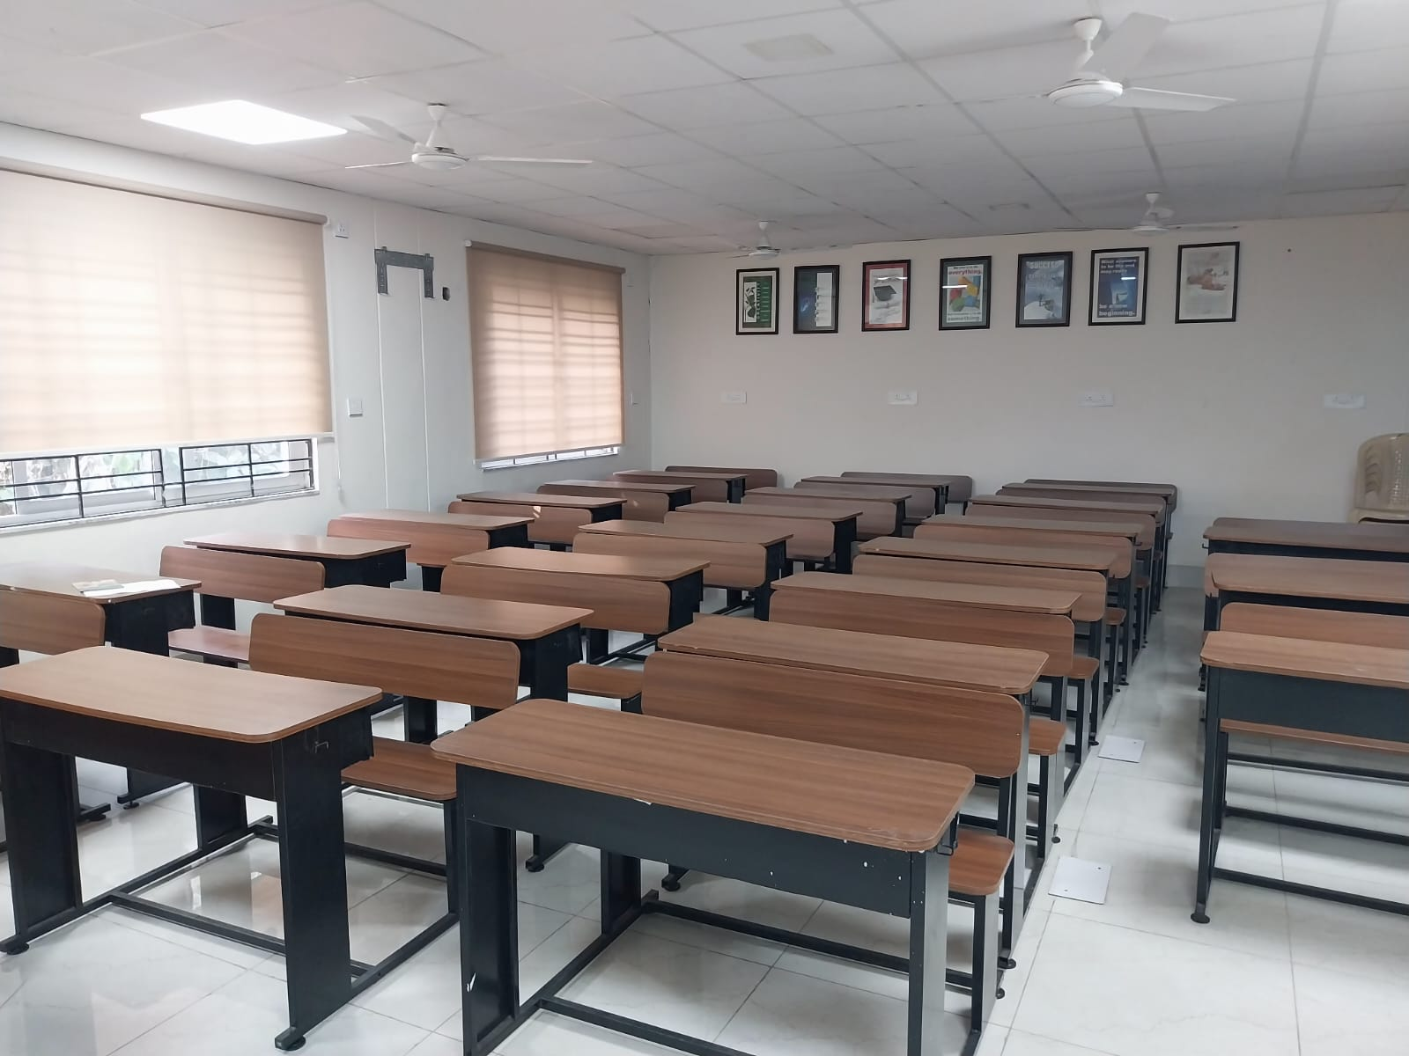
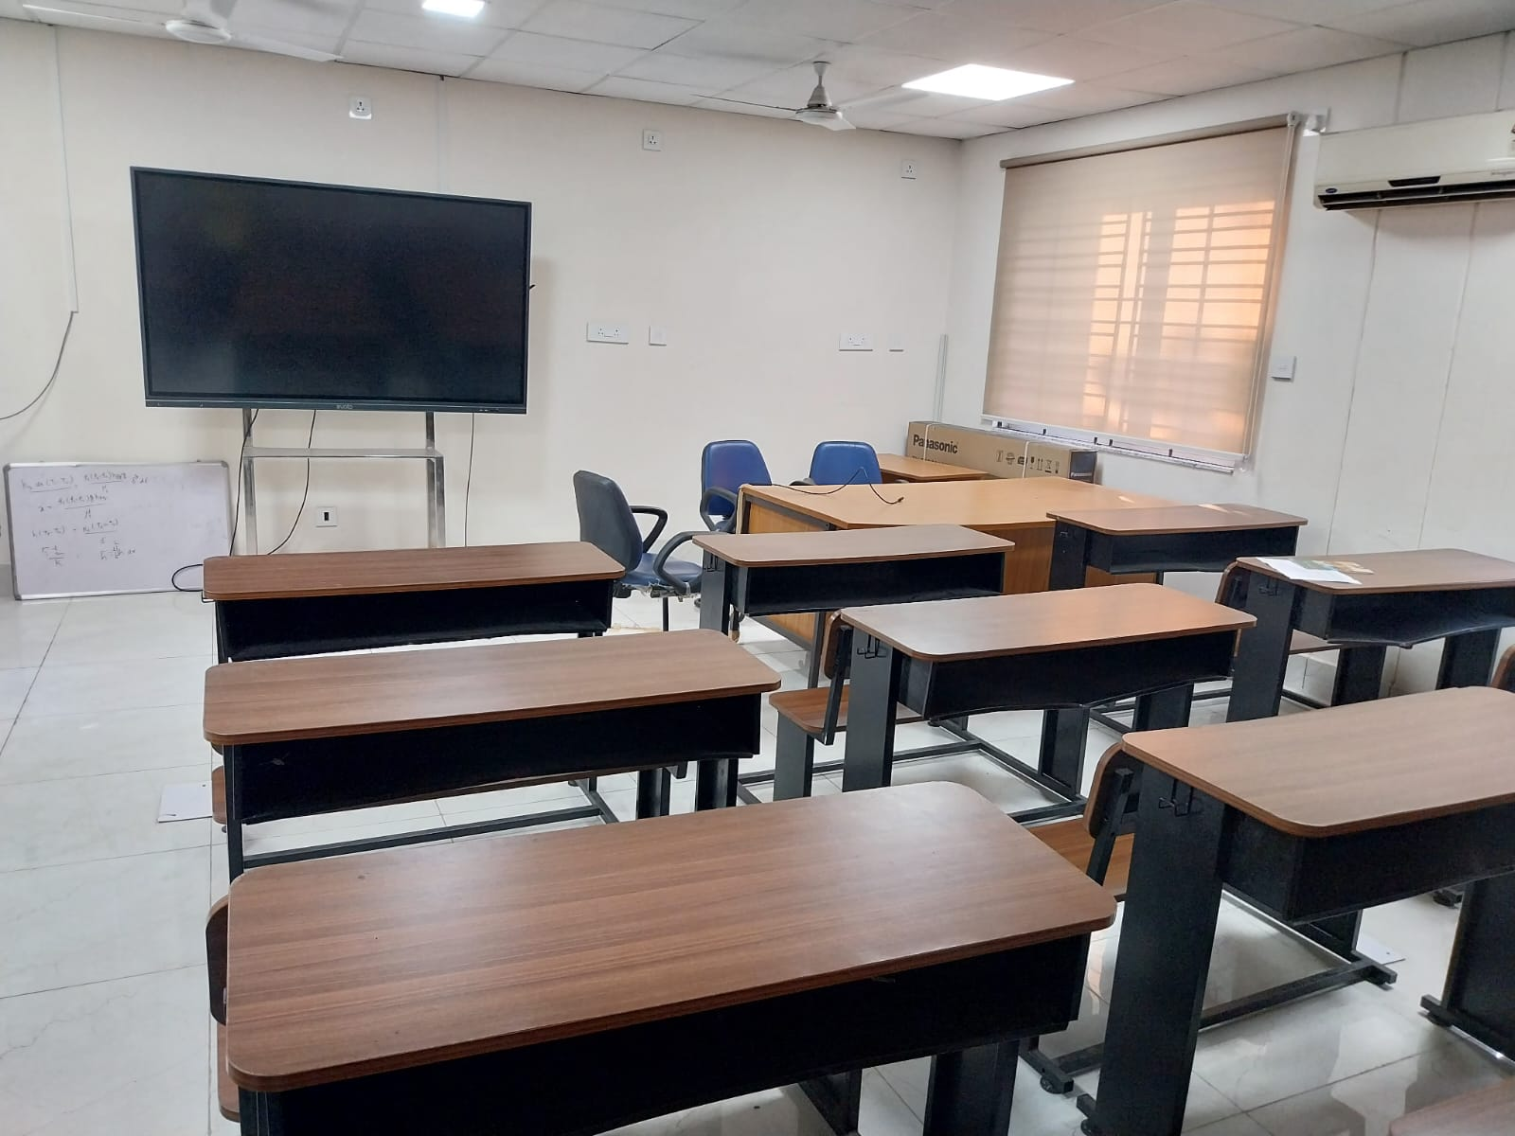

Slide 32
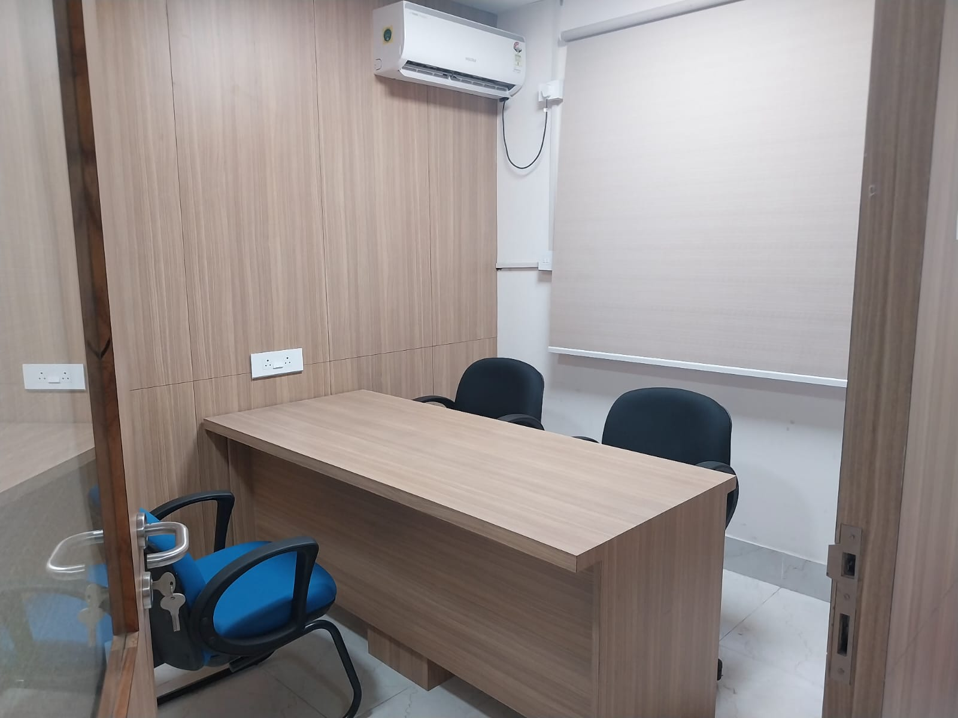
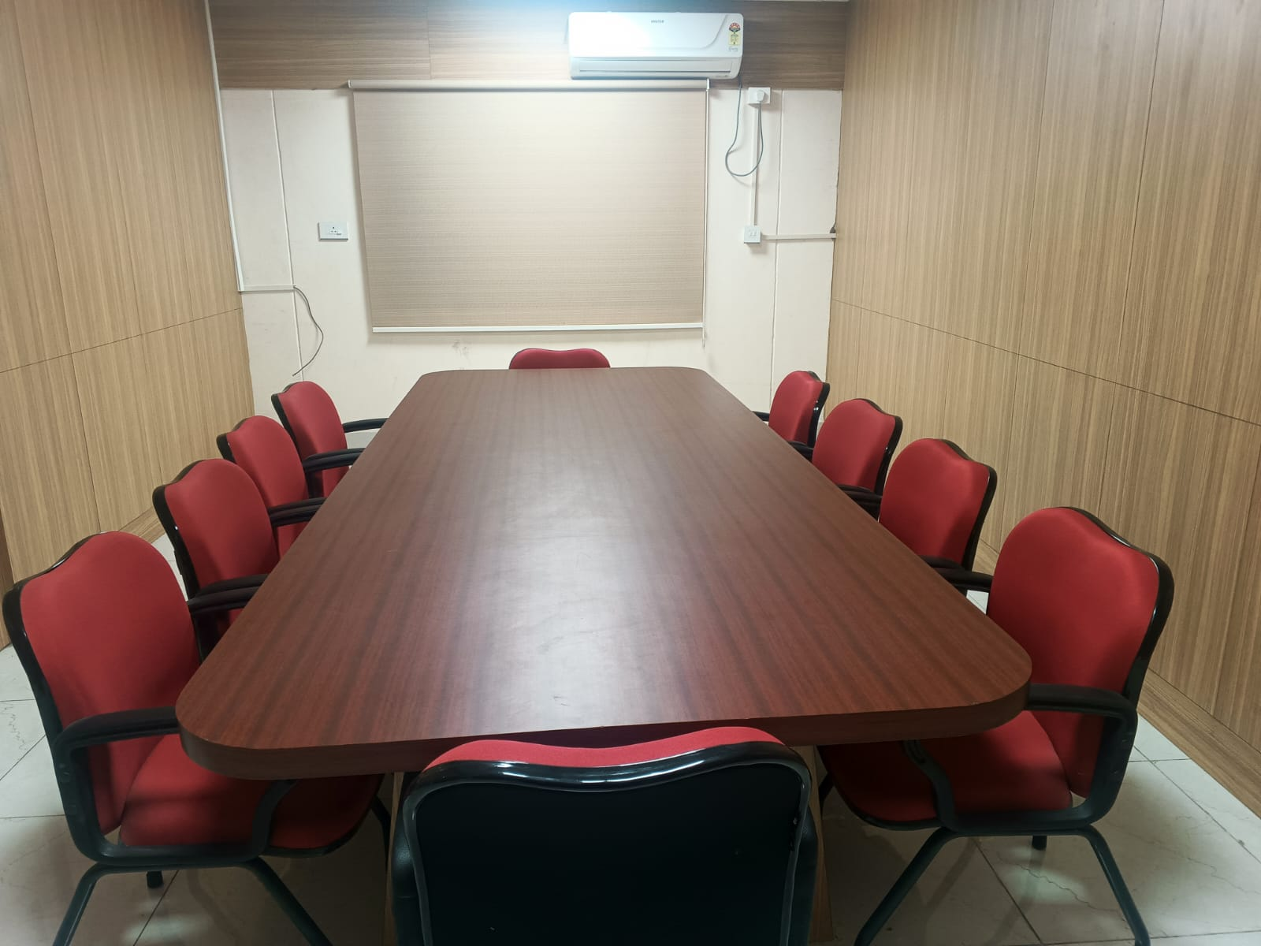

Slide 33
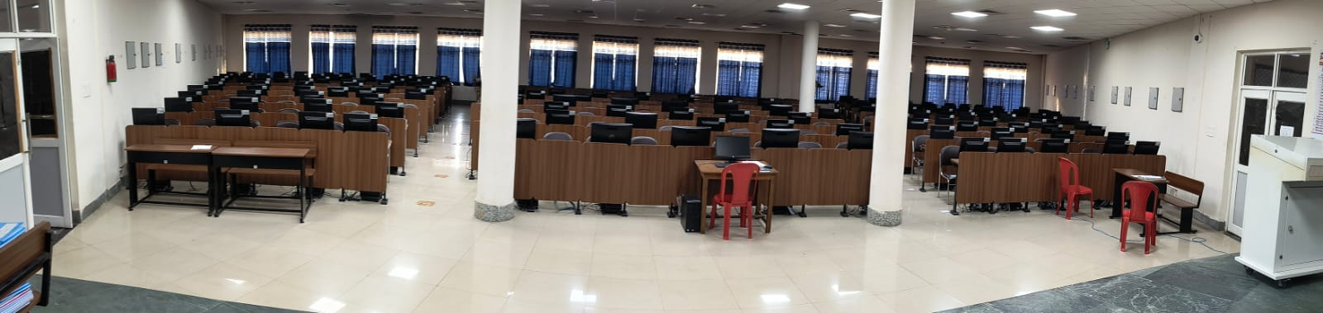
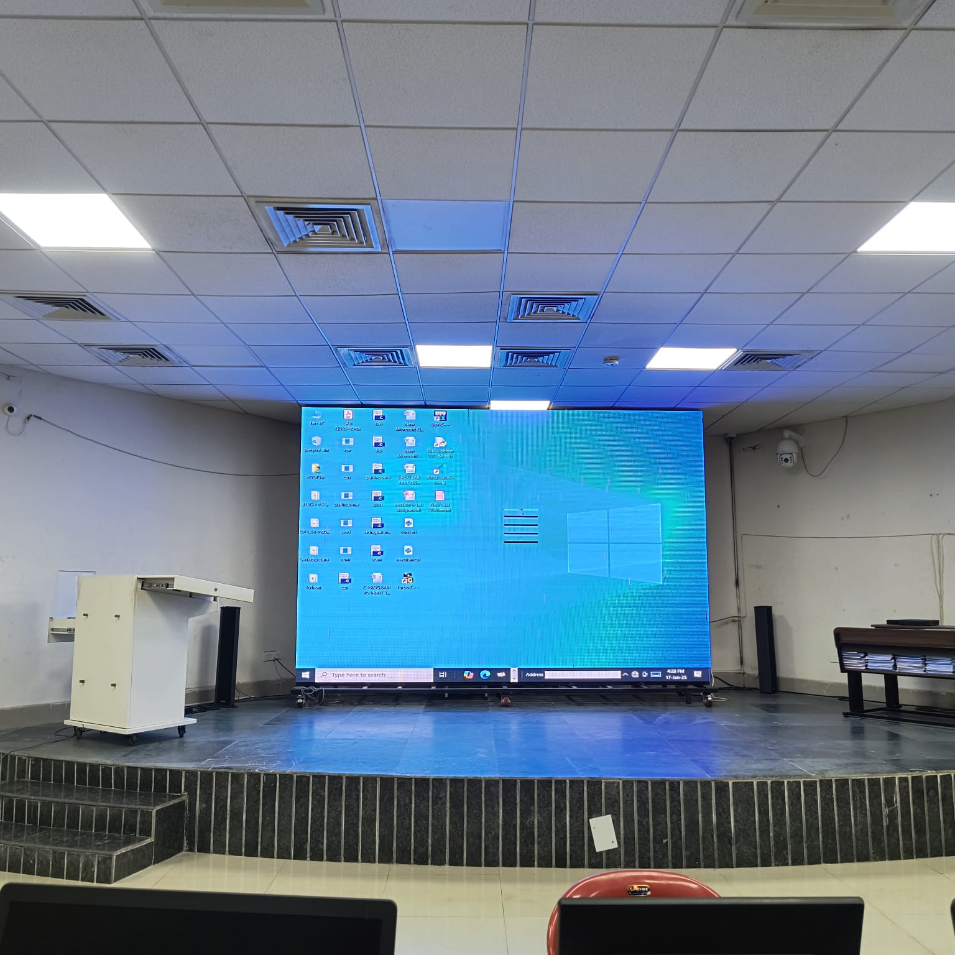

Slide 34
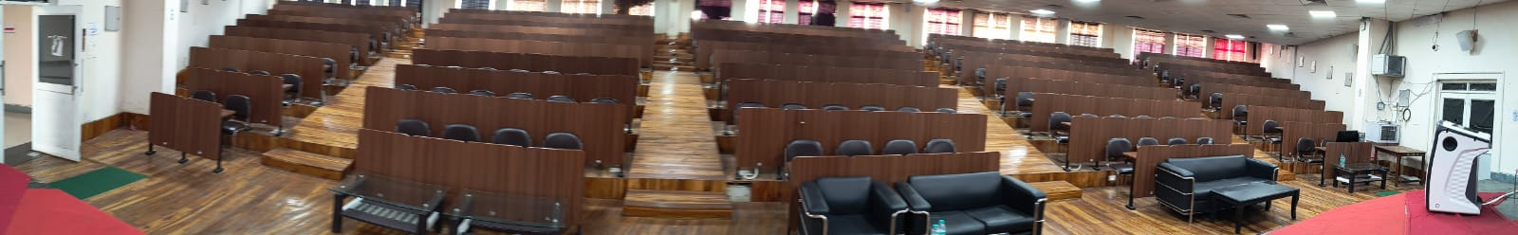
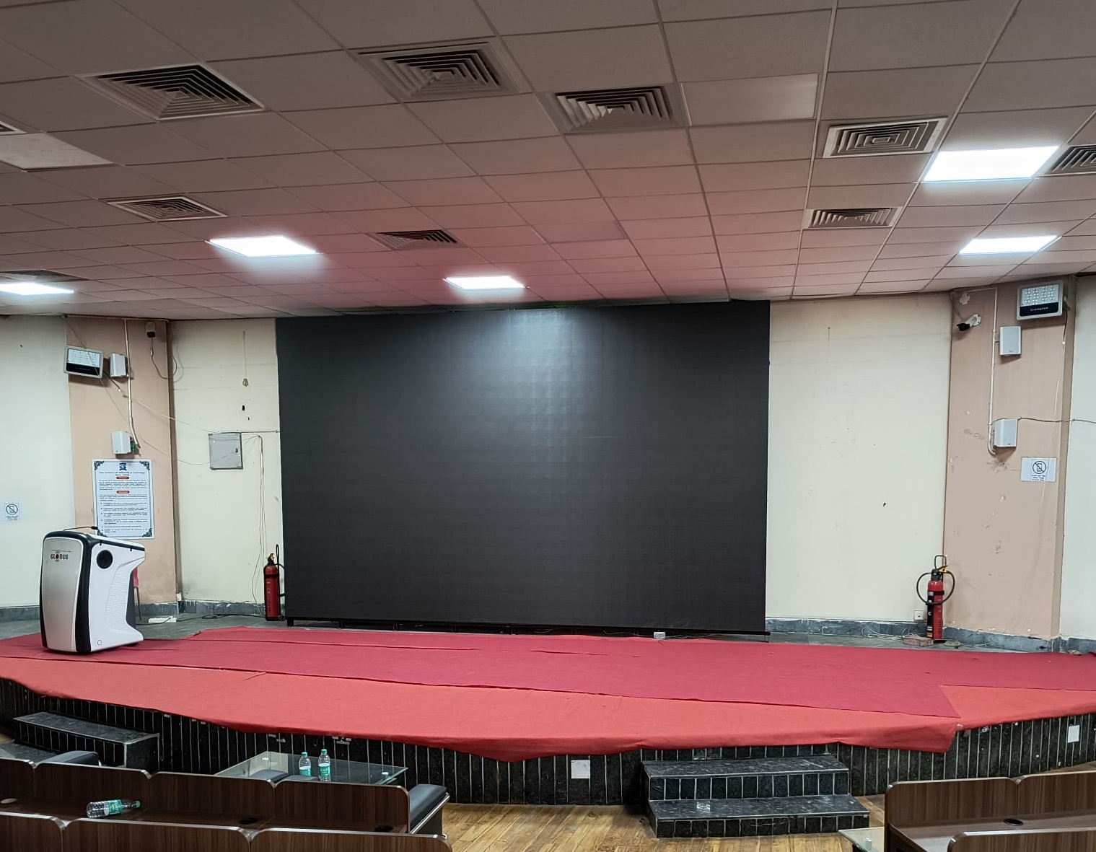

Slide 35
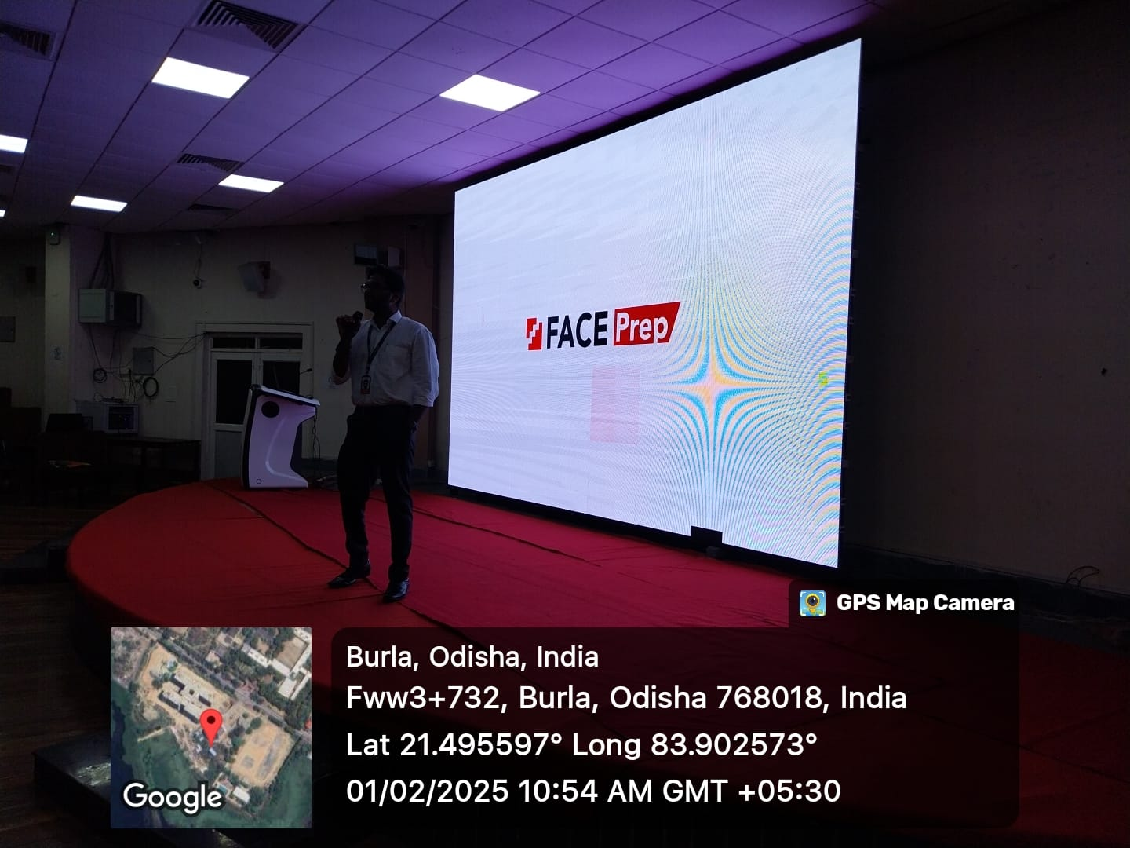
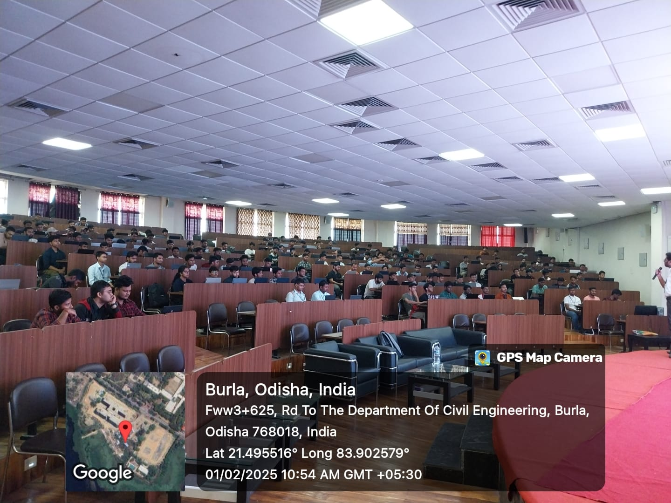
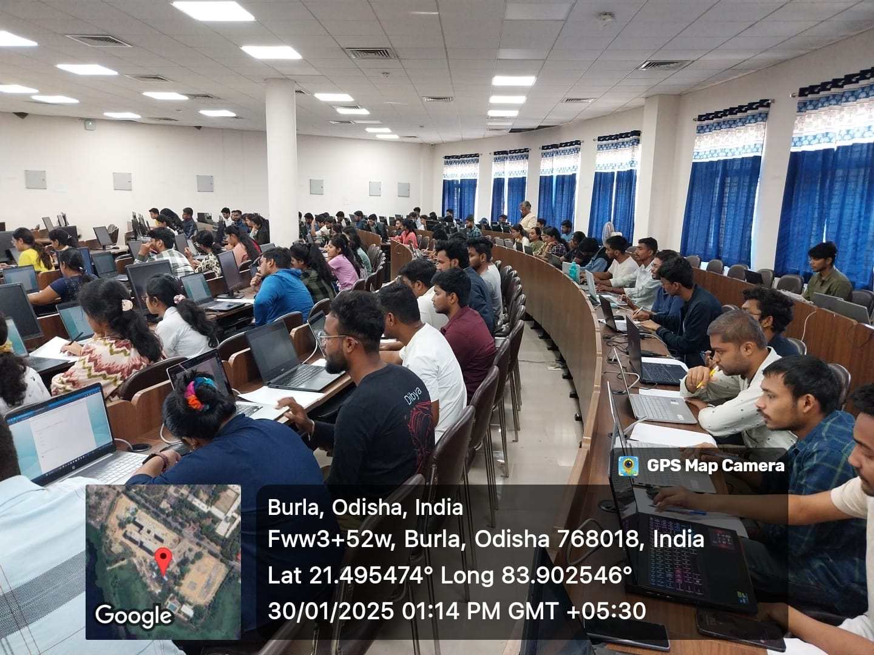
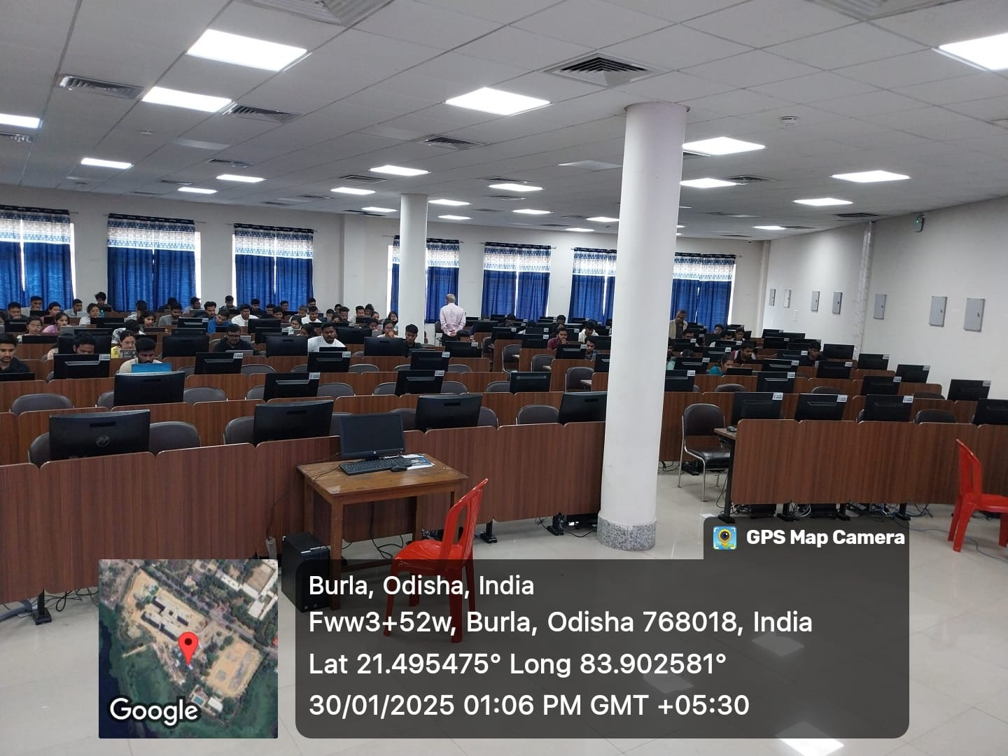

Slide 36
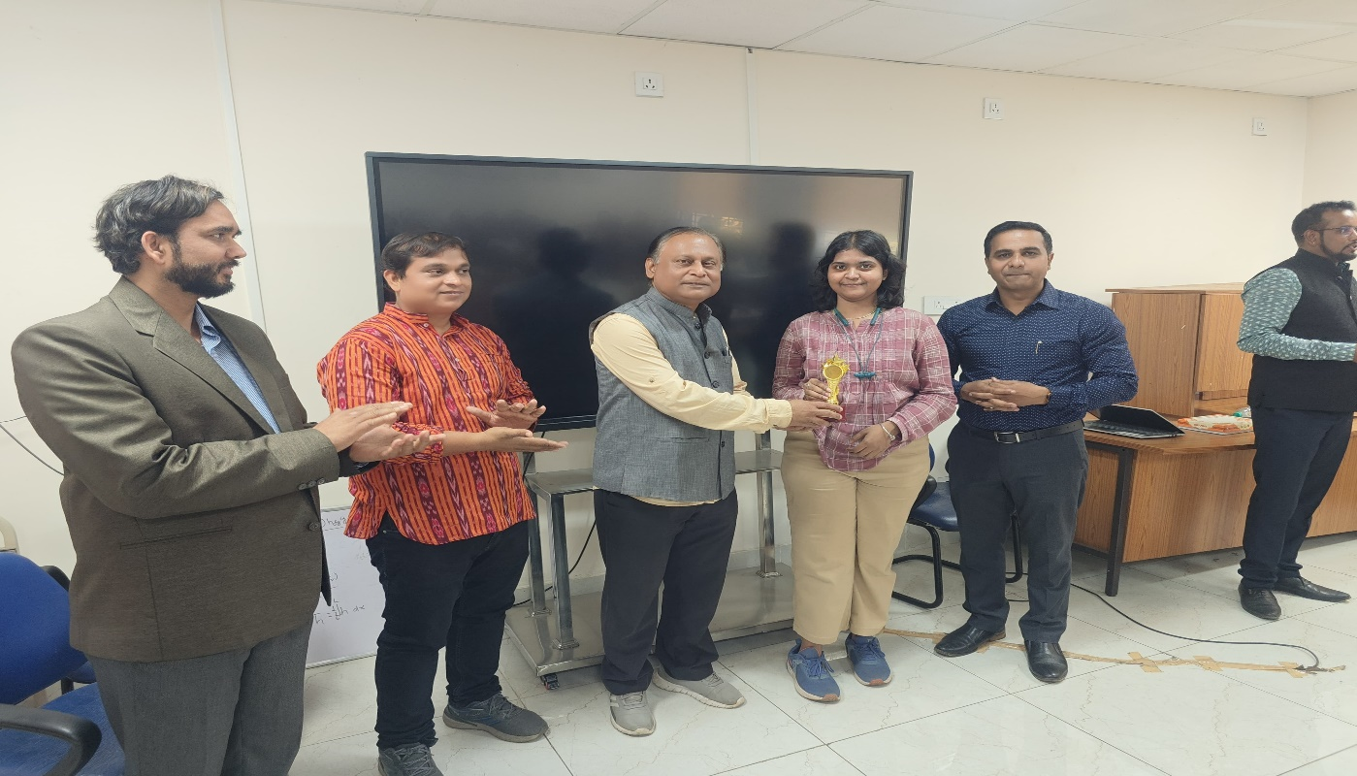
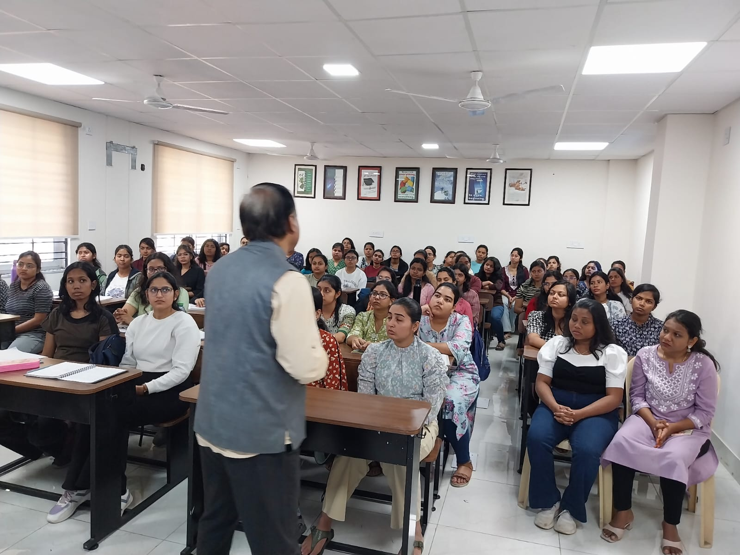
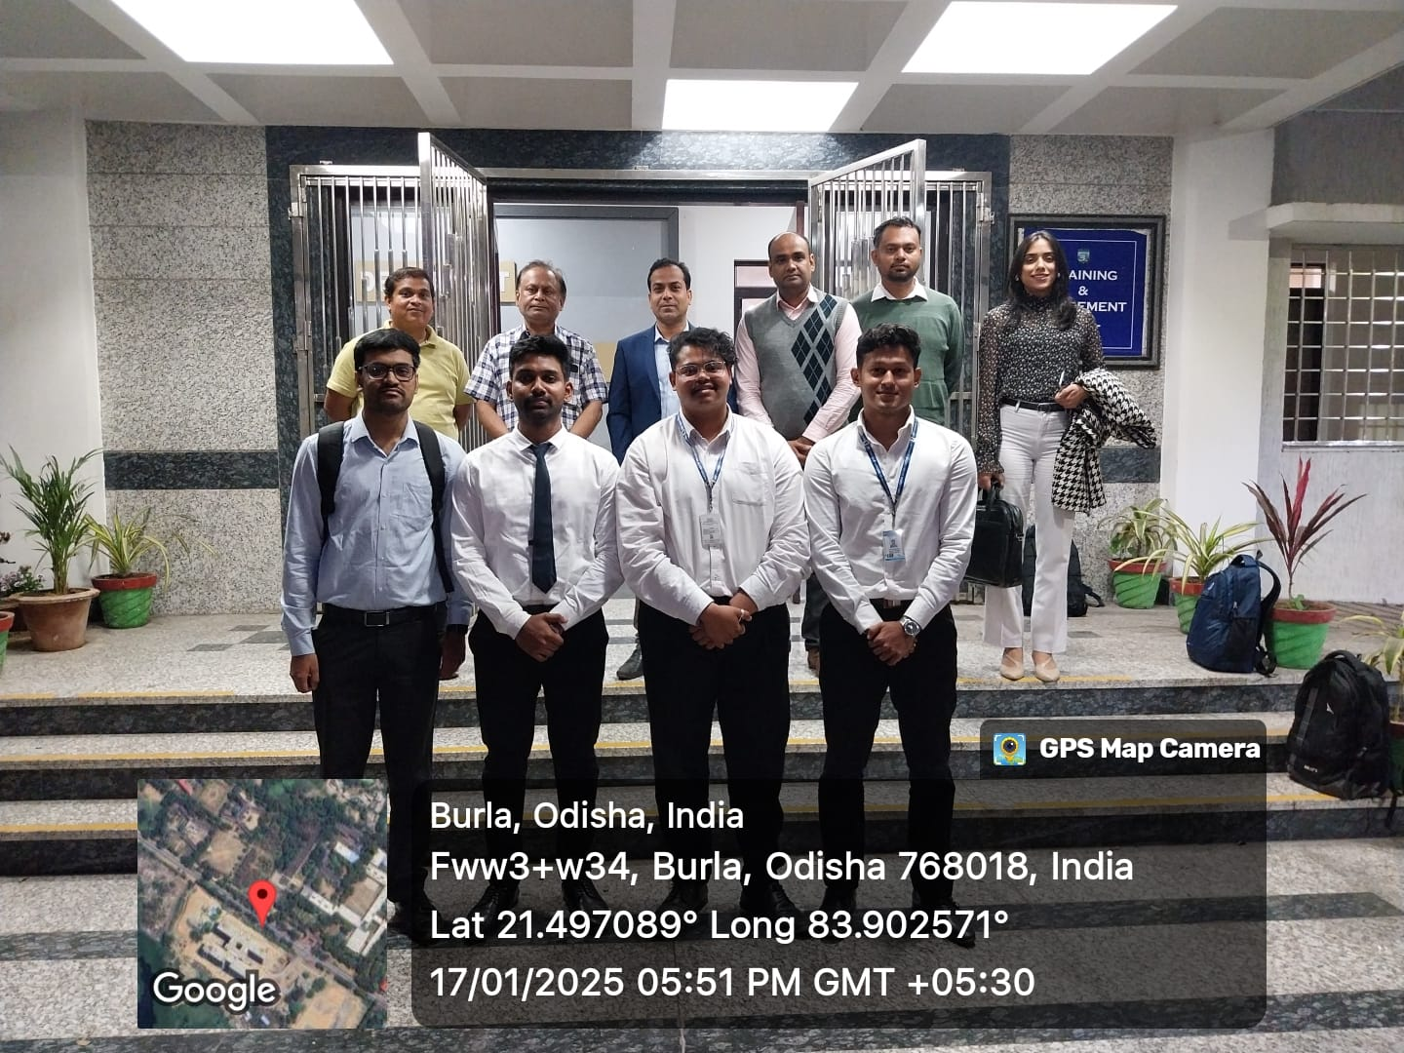
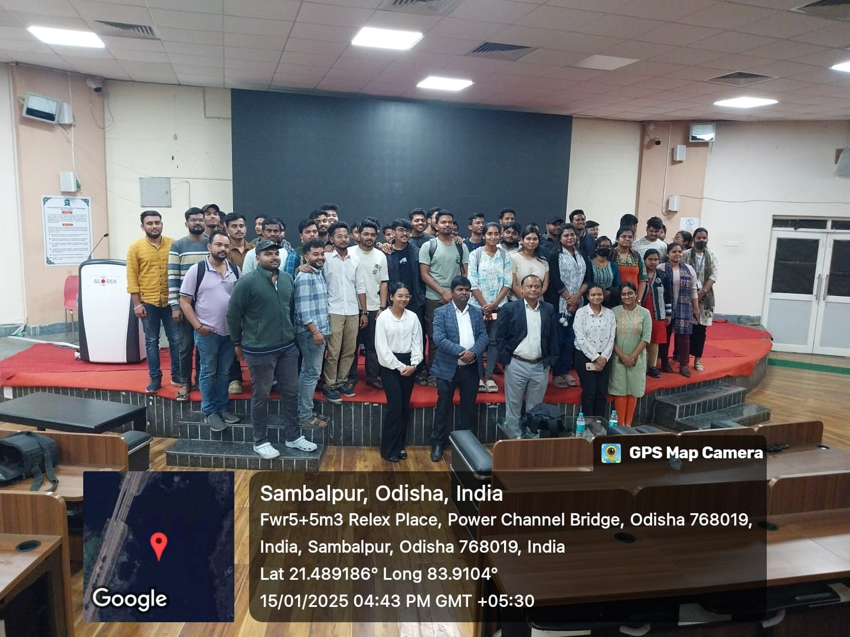

Slide 37
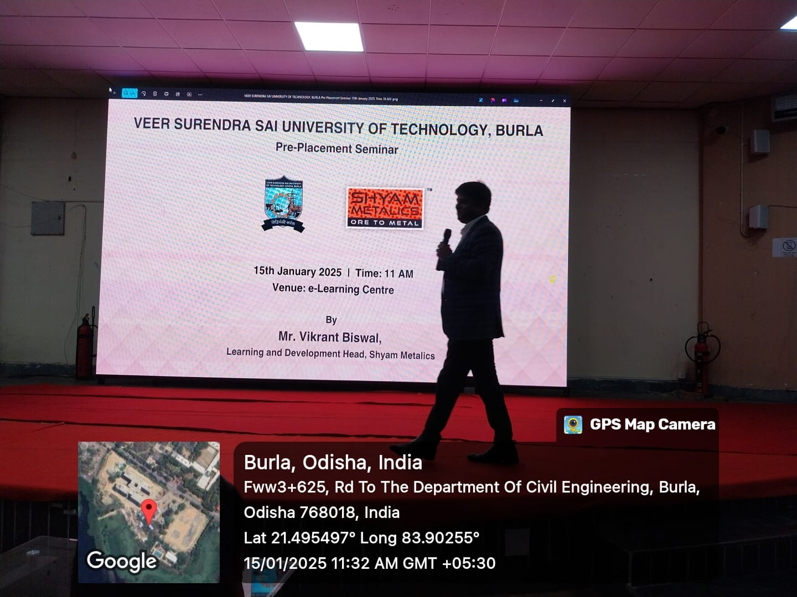
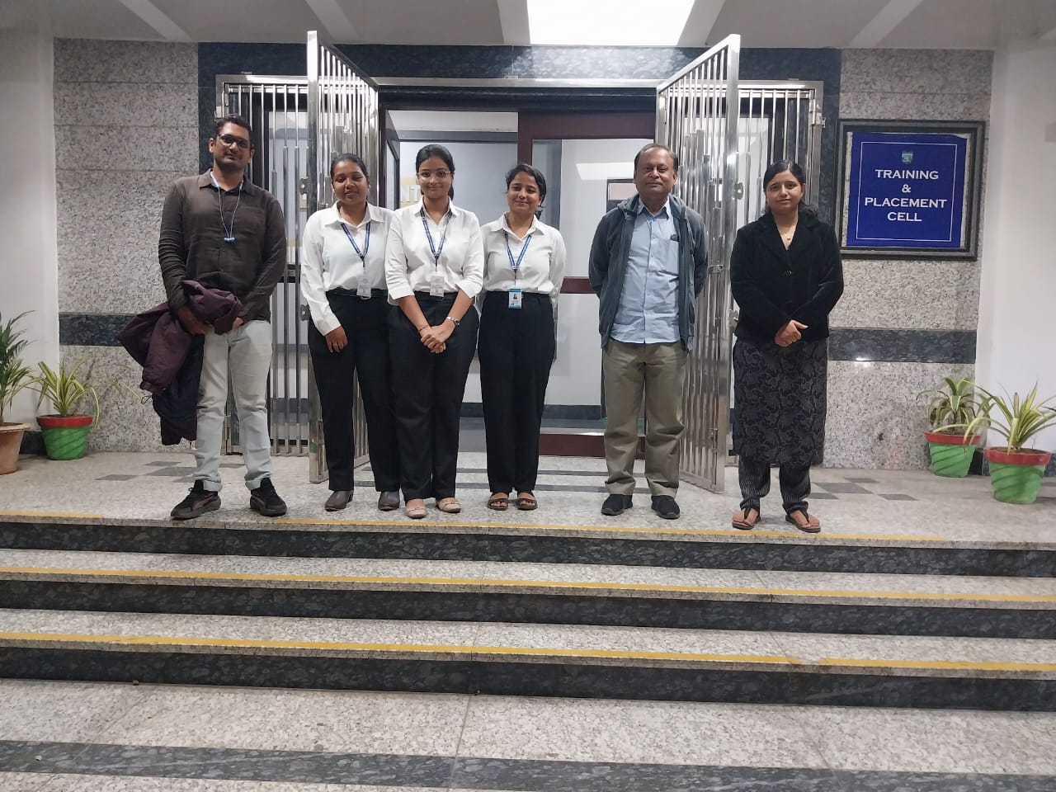
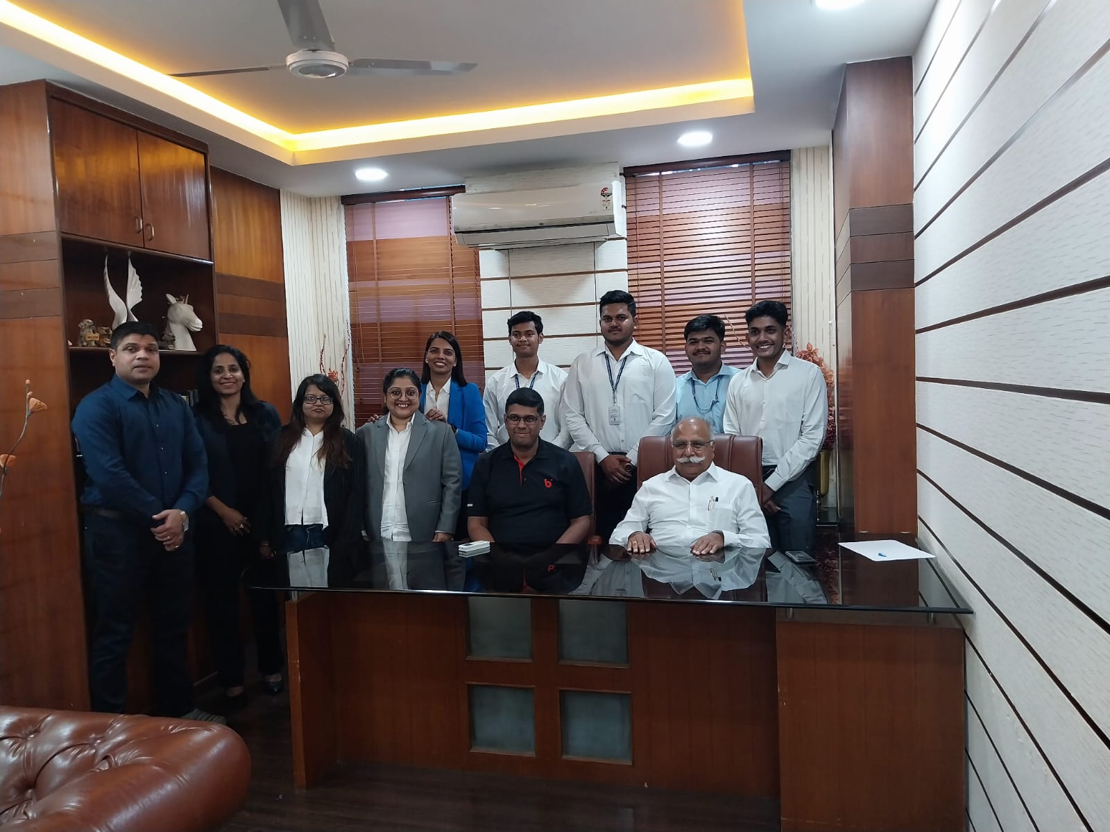
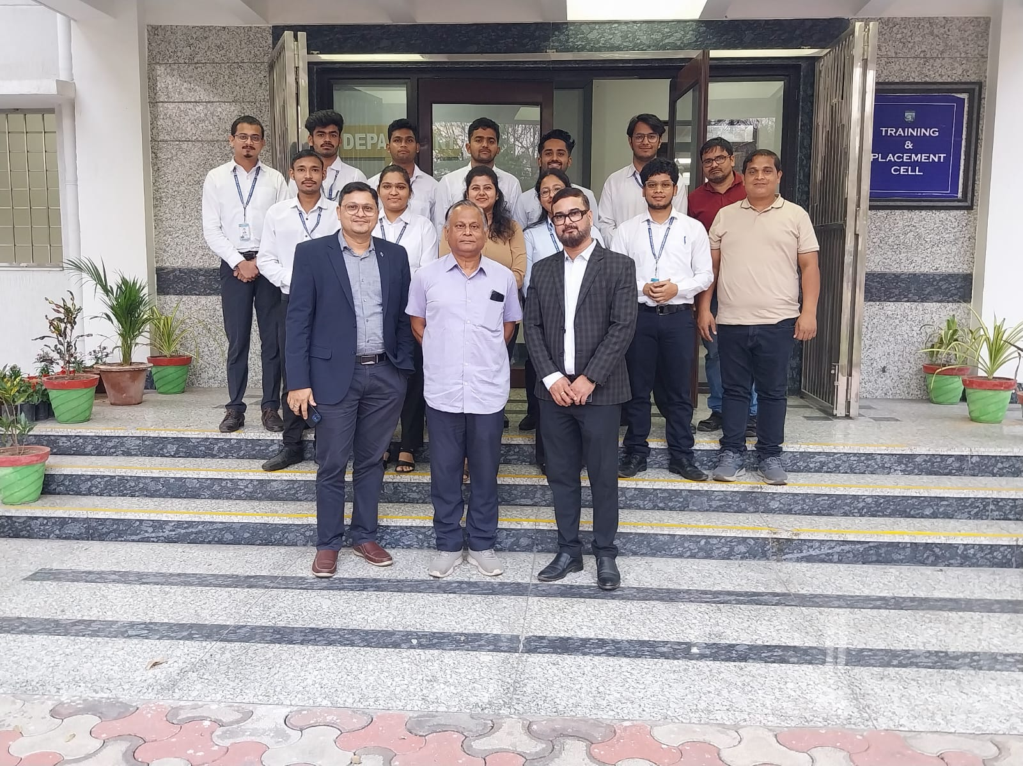

Slide 38
